Slide 1


Slide 2

Practical Data Science. For economists Week 5. University of Bristol Autumn 2022

Slide 3
Nearly half way... Re- cap, and what’s coming next
W1. Motivation, HTML, CSS. GitHub and embedding.
W2. Chart design. Raw files, editing data. String and date functions.
W3. Data: models and visualisation types. Manipulating data with Python.
W4. Data: storage types. Tidy data storage. APIs. Scraping with Python.
W5. Control structures. APIs and loops with Python.
W6. Break.
W7. Maps. Cartography history. Projections. Base maps. Putting data on maps.
W8. Advanced analytics. Transforming data. Investigating relationships.
W9. Big data. Challenges with scale. A big data cookbook.
W10. Machine Learning. History. Regressions and classification. Clustering and dimensionality reduction.
W11. Large Language Models. Gathering, cleaning, visualising data. Auditing output.

Slide 4
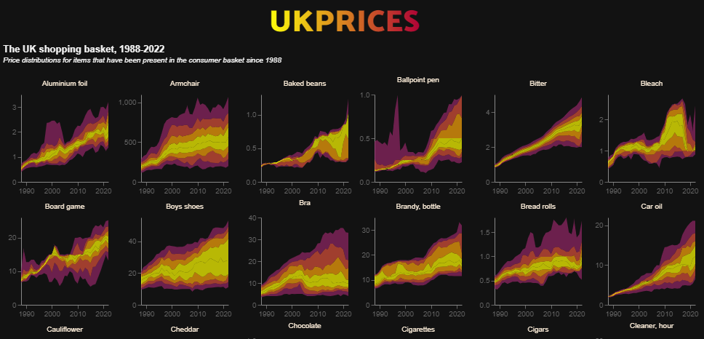
Week 5. This week
APIs and loops with Python. Making your code do the work for you.

Slide 5
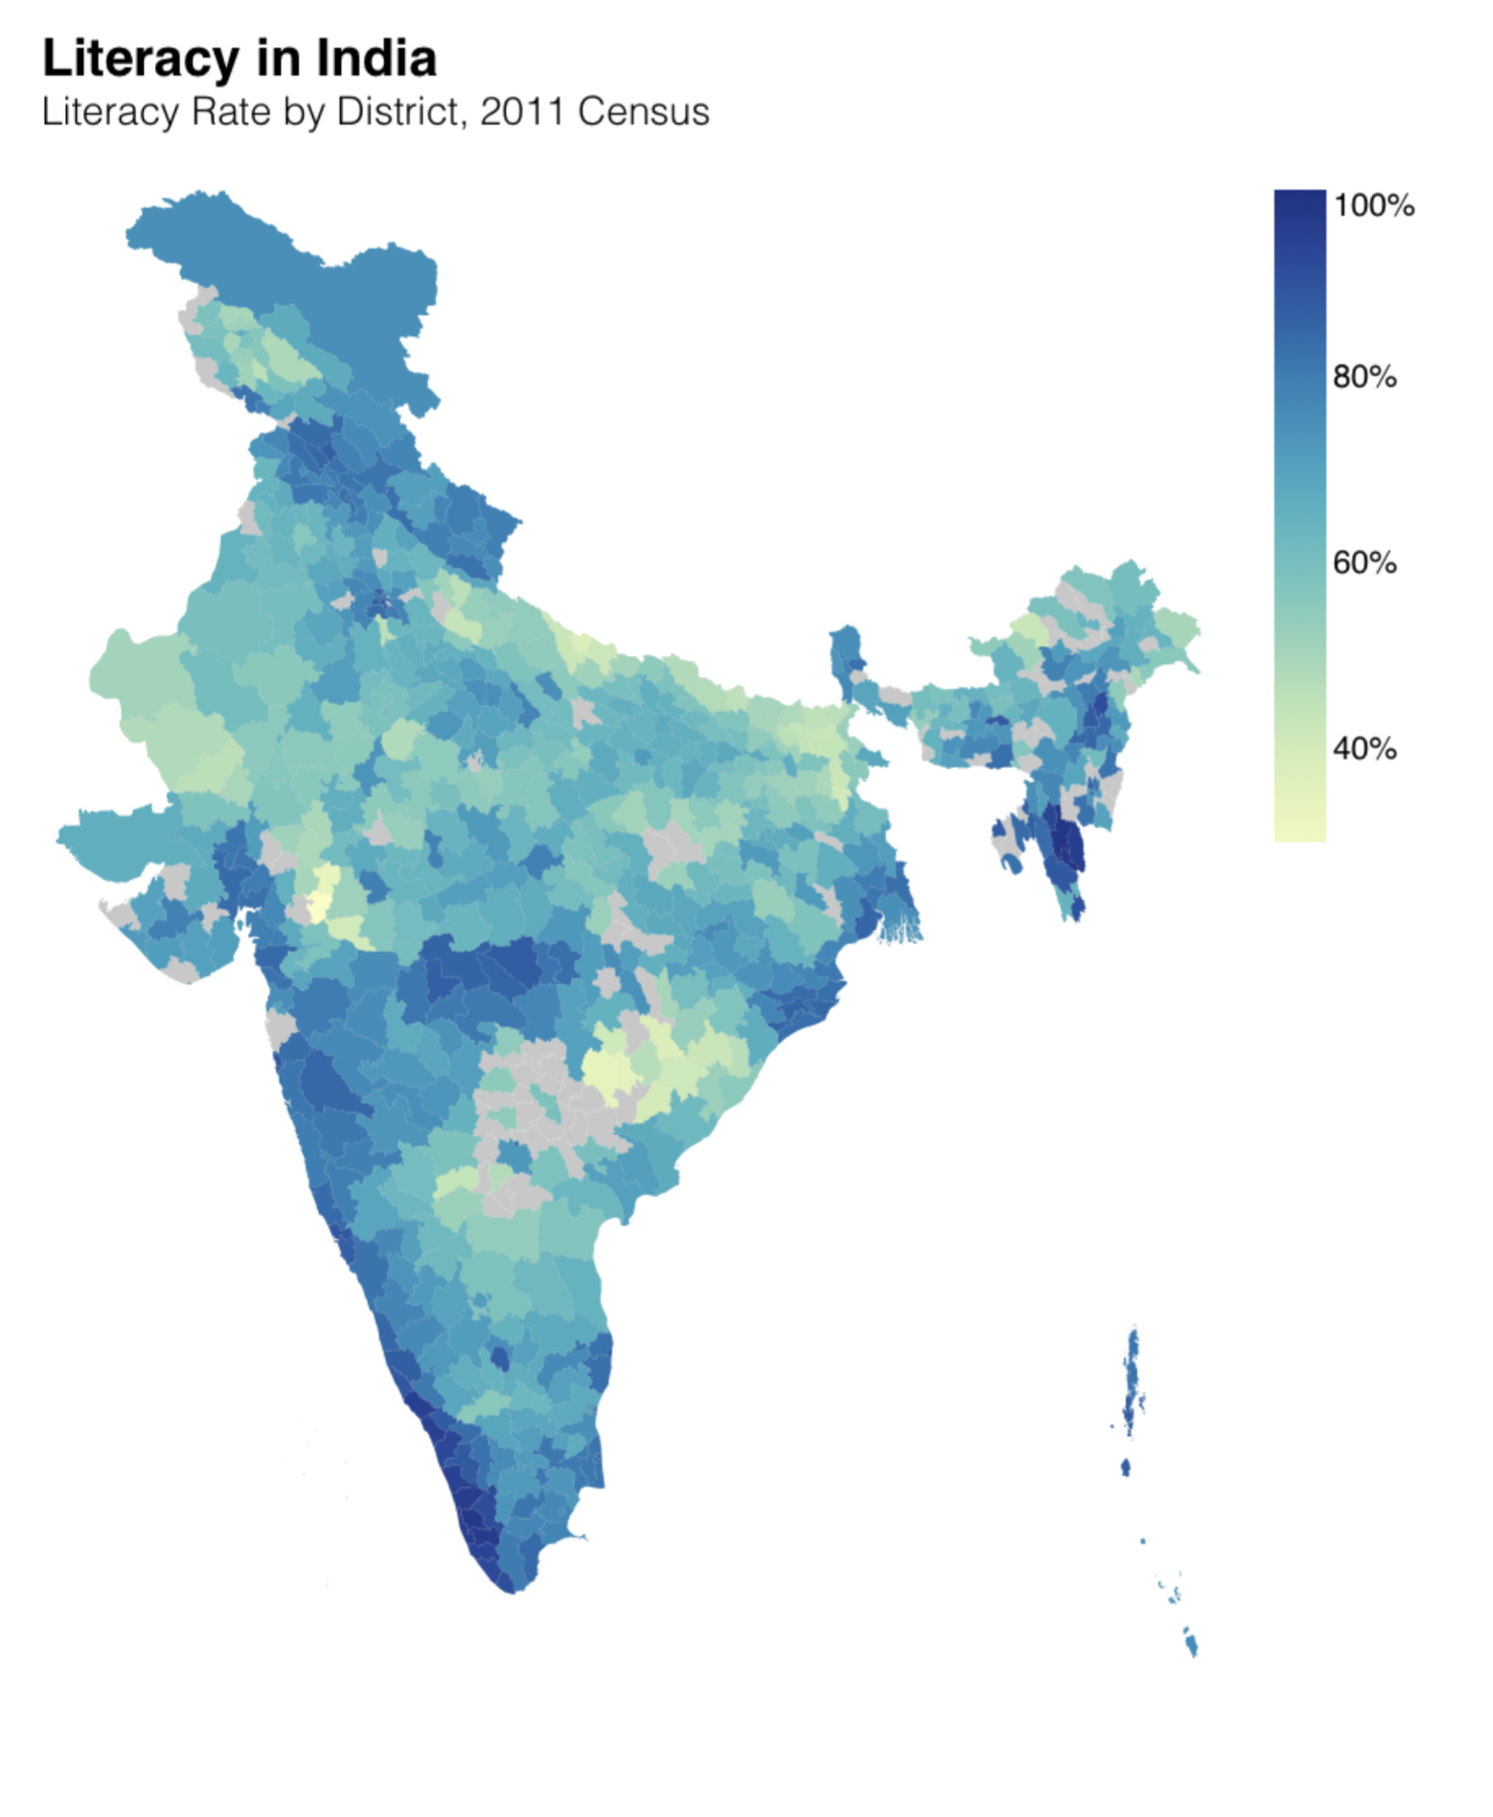
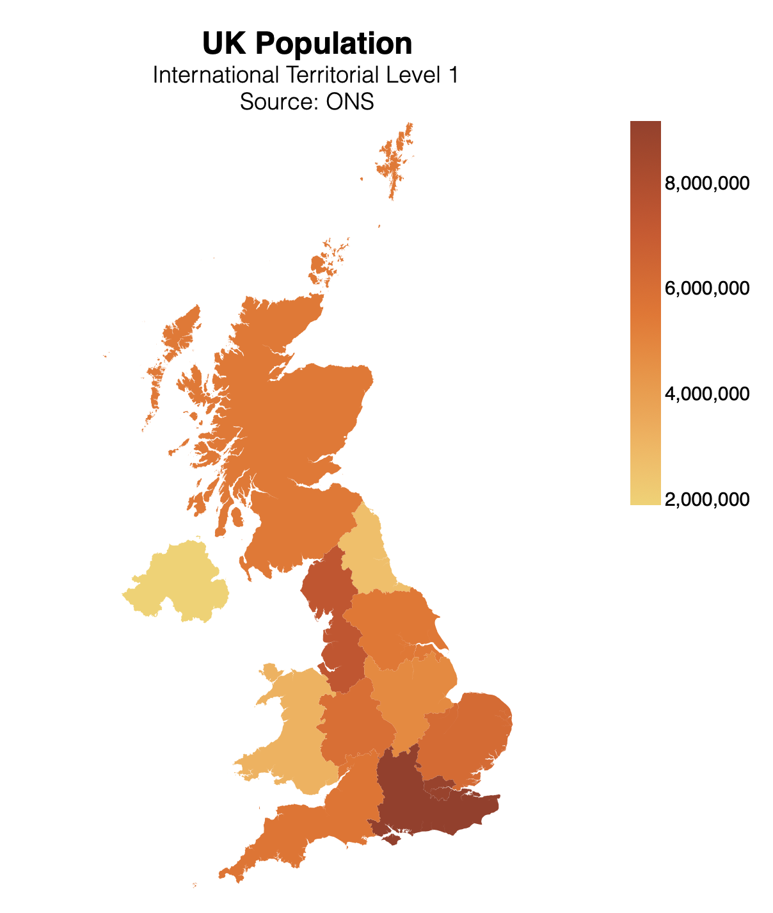
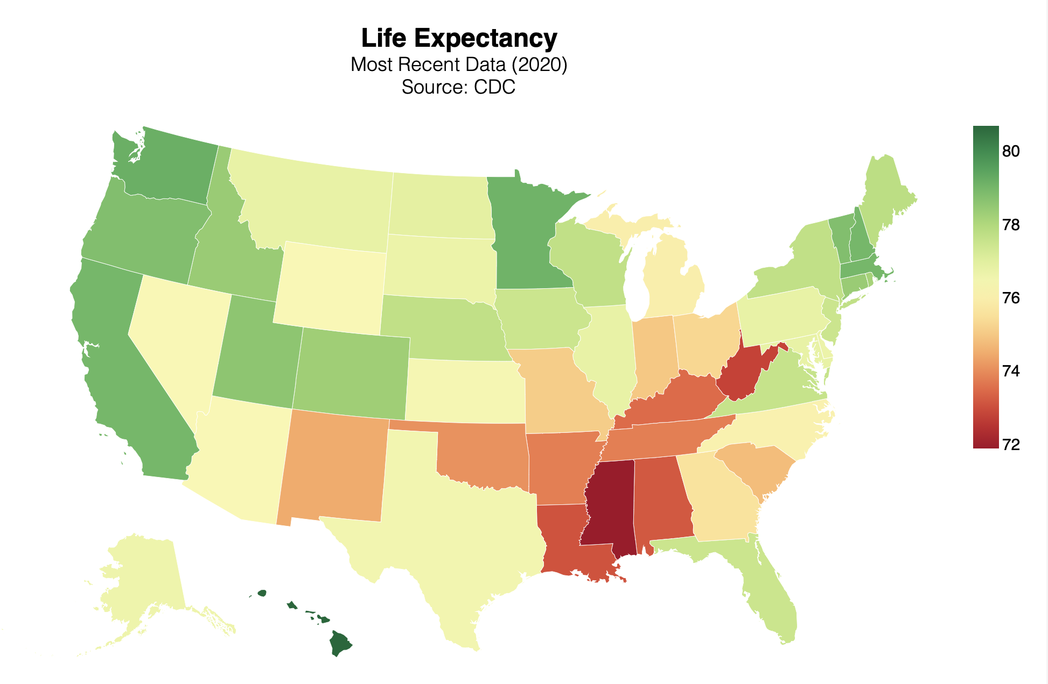
Week 6. Next week
Cartography history. Projections. Base maps. Putting your data on maps.

Slide 6
Tell us about your projects Remember, this is NOT for grading, it is so that we can help you.
Google Sheet
Please set out the working title of your project on the sheet.
This is simply so that we can see, roughly, what you are working on.
You can change project and title as you wish.

Slide 7



It’s time to complete your unit evaluation surveys
bristol.ac.uk/unit-evaluation

Slide 8

5. Programming. Making your code do the work for you

Slide 9
Week 5.
Programming. Control structures.
Conditionals. Action/selection based on a criterion.
Loops. Iteration.
Dashboards. Using this to build a dashboard.

Slide 10
5.1 Control Structures. Concepts, languages

Slide 11
The idea.
Control structures | Flow control | Control statements
We want our programs/analysis to take decisions for us. Not to continue doing the same thing again and again, but to be able to decide what to do next.
Without control structures (AKA ‘flow control’) programs don’t do much.
What might you want a program to do for you?
Stop or start.
Take a decision on what to do next. Do different things in different conditions:
Time of day, or days of the week;
If data has certain properties: (stock market alert).
Do something many times.
Dynamic programming / maximisation;
Batches of analysis: downloading, cleaning, charting.

Slide 12
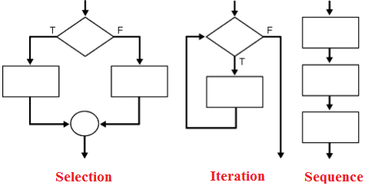
The big three.
Sequence | Iteration | Conditionality/Selection
Programming languages typically feature three types of control:
Sequence. Tells the program the order to do things in.
Selection/conditionality. Makes a decision based on a testable condition.
Iteration. Repeats a command over and over again, until a condition is met. Then stop and continue the code.

Slide 13
Control in data science.
If-else | Loops
In practical terms during a career in data you are going to make daily use two particular examples of these general ideas.
If-else. Test some condition in your data. Based on the results of this test, take a number of different actions.
Loops. Do the same thing to many pieces of data, many variables, many data sets. Or do the same thing on a number of different days.
These can be combined all possible ways.
An if statement inside an if (AKA “nested”)
A loop withing a loop.
If inside a loop
Loop inside an if.

Slide 14





How many languages?
Five?

Slide 15
How many languages?
Three?

Slide 16
5.2 Conditionals. A fork in the road

Slide 17

Code as a tree | Conditional statements influence which branch your code goes along.

Slide 18
If-else.
Excel | STATA | Python | JavaScript | CSS
Syntax:
IF({CONDITION}, {VALUE IF TRUE}, {VALUE IF FALSE})
Example:
=if(A1=“Richard”, “Yes”, “No”)

Slide 19
If-else.
Excel | STATA | Python | JavaScript | CSS
Practical usage:
Data cleaning
You have two data sets on countries that you want to match.
But the names are not consistent.
You want to create a column that provides a 1:1 correspondence between the data sets
=if(A1=“Côte d'Ivoire”, “Ivory Coast”, A1)
Categorisation
You have data on firm size, measured by number of employees…
You want to analyse based on two types, large firms and SMEs..
You define SME as anything with up to 250 employees..
=if(A1>250, “Large”, “SME”)

Slide 20
If-else – what does equal mean?
Excel | STATA | Python | JavaScript | CSS
?
= == ===

Slide 21
=, == and ===
Three uses of equals signs: Stata | JS | Python
= Assigns value | i.e. it makes the thing on the left equal the thing on the right.
== Tests value | It checks whether the thing on the left is equal to the thing on the right.
=== Tests value and type | Is the thing on the left the same value and the same type (number, word, etc) as the thing on the right.

Slide 22
If-else – what does equal mean?
Excel | STATA | Python | JavaScript | CSS
Joe = President
Joe == President
Joe === President

Slide 23
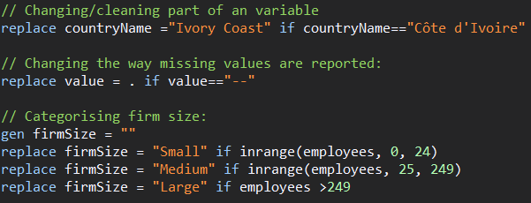
If-else.
Excel | STATA | Python | JavaScript | CSS

Slide 24
If-else.
Excel | STATA | Python | JavaScript | CSS
# Simple if:
if CONDITION:
#Code to run if true
#Can be more than one line
# If else:
if CONDITION:
# Code to run if true
else
# Code to run if condition is FALSE
# Elif
if CONDITION_A:
# Code to run if conditionA TRUE.
elif CONDITION_B:
# Code to run if conditionB TRUE.
else:
# Code to run if BOTH conditions are FALSE.

Slide 25
If-else.
Excel | STATA | Python | JavaScript | CSS
# Example: how big are firms in our dataset?
firm1 = 14
firm2 = 250
# Comparing values
if firm1 > firm2:
print("Firm 1 has more employees than Firm 2")
else:
print("Firm 2 has more employees than Firm 1")
# Assessing size
if firm1 > 249:
print("Firm 1 is large")
else:
print("Firm 1 is an SME")

Slide 26
If-else.
Excel | STATA | Python | JavaScript | CSS
//Simple if condition
if (condition) {
// Add code here--can be many lines, to run if the condition is TRUE.
// If the condition is FALSE then nothing happens
}
//If else
if (condition) {
// Code to run if condition TRUE.
} else {
// Code to run if condition FALSE.
}
//If-elif-else:
if (conditionA) {
// Code to run if conditionA TRUE.
} else if (conditionB) {
// Code to run if conditionB TRUE.
} else {
// Code to run if BOTH conditionA and conditionB are FALSE.
}

Slide 27
If-else.
Excel | STATA | Python | JavaScript | CSS
CSS does not officially support conditionals.
But there is a way we can make CSS react in different ways in different situations?
Media Queries (@media) allow you to change the look based on screen size:
With these you are saying:
If the screen size is {CONDITION} then do this {ACTION}
So CSS does allow conditionals.
Understanding this is the way to make your site have two looks: one for mobile, one for laptop/desktop.

Slide 28
Examples. Why are conditionals so useful?

Slide 29
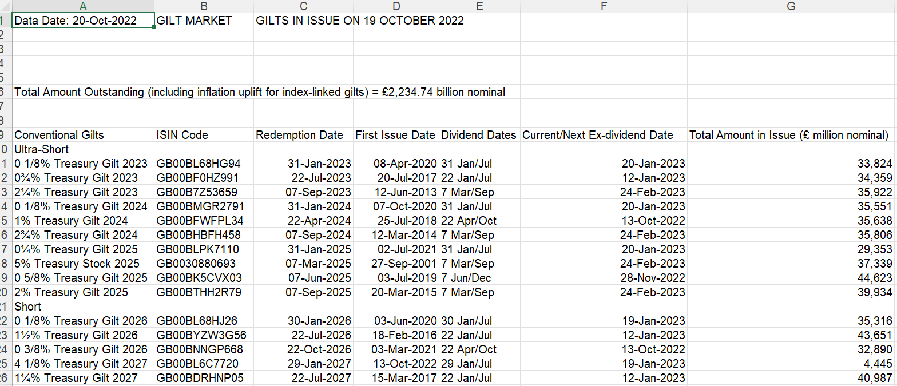
Example 1. Cleaning. UK Gilt Market
Excel | STATA | Python | JavaScript | CSS
https://dmo.gov.uk/data/gilt-market/gilts-in-issue/

Slide 30
Example 1. UK Gilt Market
How would you clean this data?
0 1/8% Treasury Gilt 2023
0¾% Treasury Gilt 2023
2¼% Treasury Gilt 2023
5% Treasury Stock 2025
1 5/8% Treasury Gilt 2028
6% Treasury Stock 2028
0¼% Treasury Gilt 2031
1% Treasury Gilt 2032
4¼% Treasury Stock 2032
0 7/8% Green Gilt 2033
4½% Treasury Gilt 2034
1 1/8% Treasury Gilt 2073
0 1/8% Index-linked Treasury Gilt 2046
0¾% Index-linked Treasury Gilt 2047
0 1/8% Index-linked Treasury Gilt 2048
0½% Index-linked Treasury Gilt 2050
4 1/8% Index-linked Treasury Stock 2030
2% Index-linked Treasury Stock 2035
Cleaning data is often a matter of:
1. Spotting patterns in the data. Where in the mess of string does the number that you want appear?
2. Using string functions to split, separate and change the data in other ways.
You will very often us programming logic – if statements – to do this.

Slide 31
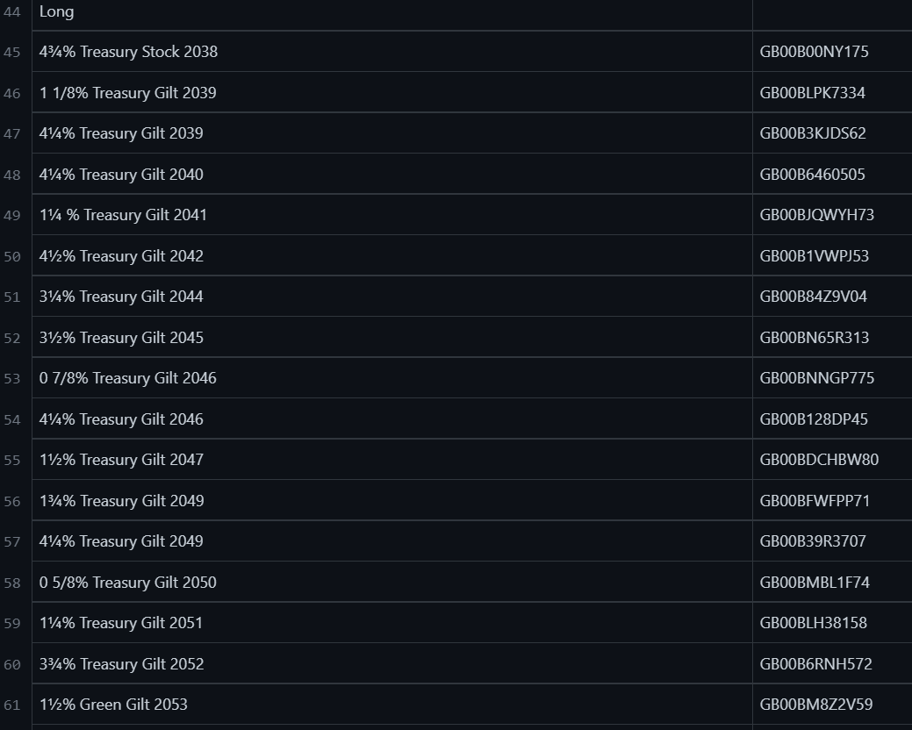
Example 1. UK Gilt Market
Excel | STATA | Python | JavaScript | CSS
https://github.com/RDeconomist/RDeconomist.github.io/blob/main/data/GiltsInIssueRaw.csv

Slide 32
Example 1. UK Gilt Market
Excel | STATA | Python | JavaScript | CSS
[...]
///////////////////////////////////////////////////////////////////
//2. USING STRING FUNCTIONS TO CLEAN THE DATA:
// Destring:
destring issueAmount baseRPI amountINCinfUplift, ignore("," ) replace
// Problem variable: looks like this:
// "0 5/8% Treasury Gilt 2025"
// We want to ge the type, and the coupon.
/// String split, based on a character:
split type, parse("T") generate(type2)
order type*
/// String concatenate:
** This adds back the missing "T".
gen T = "T"
replace type22 = T+type22
drop T
/// Genearting a substring, based on the kown position of a chatacter:
replace type22 = substr(type22, 1, strpos(type22, "2") - 1)
/// Trimming the leading and trailing spaces from around a variable:
replace type22 = strrtrim(type22)
[...]
With a combination of string functions, we can clean the raw data with Stata:
Upper, lower
Split:
At a fixed position.
At a character.
Concatenate
Measuring:
Find the Length
Find the position of a character
Substring
Trim
github.com/RDeconomist/RDeconomist.github.io/blob/main/data/giltsCleaningData.do

Slide 33
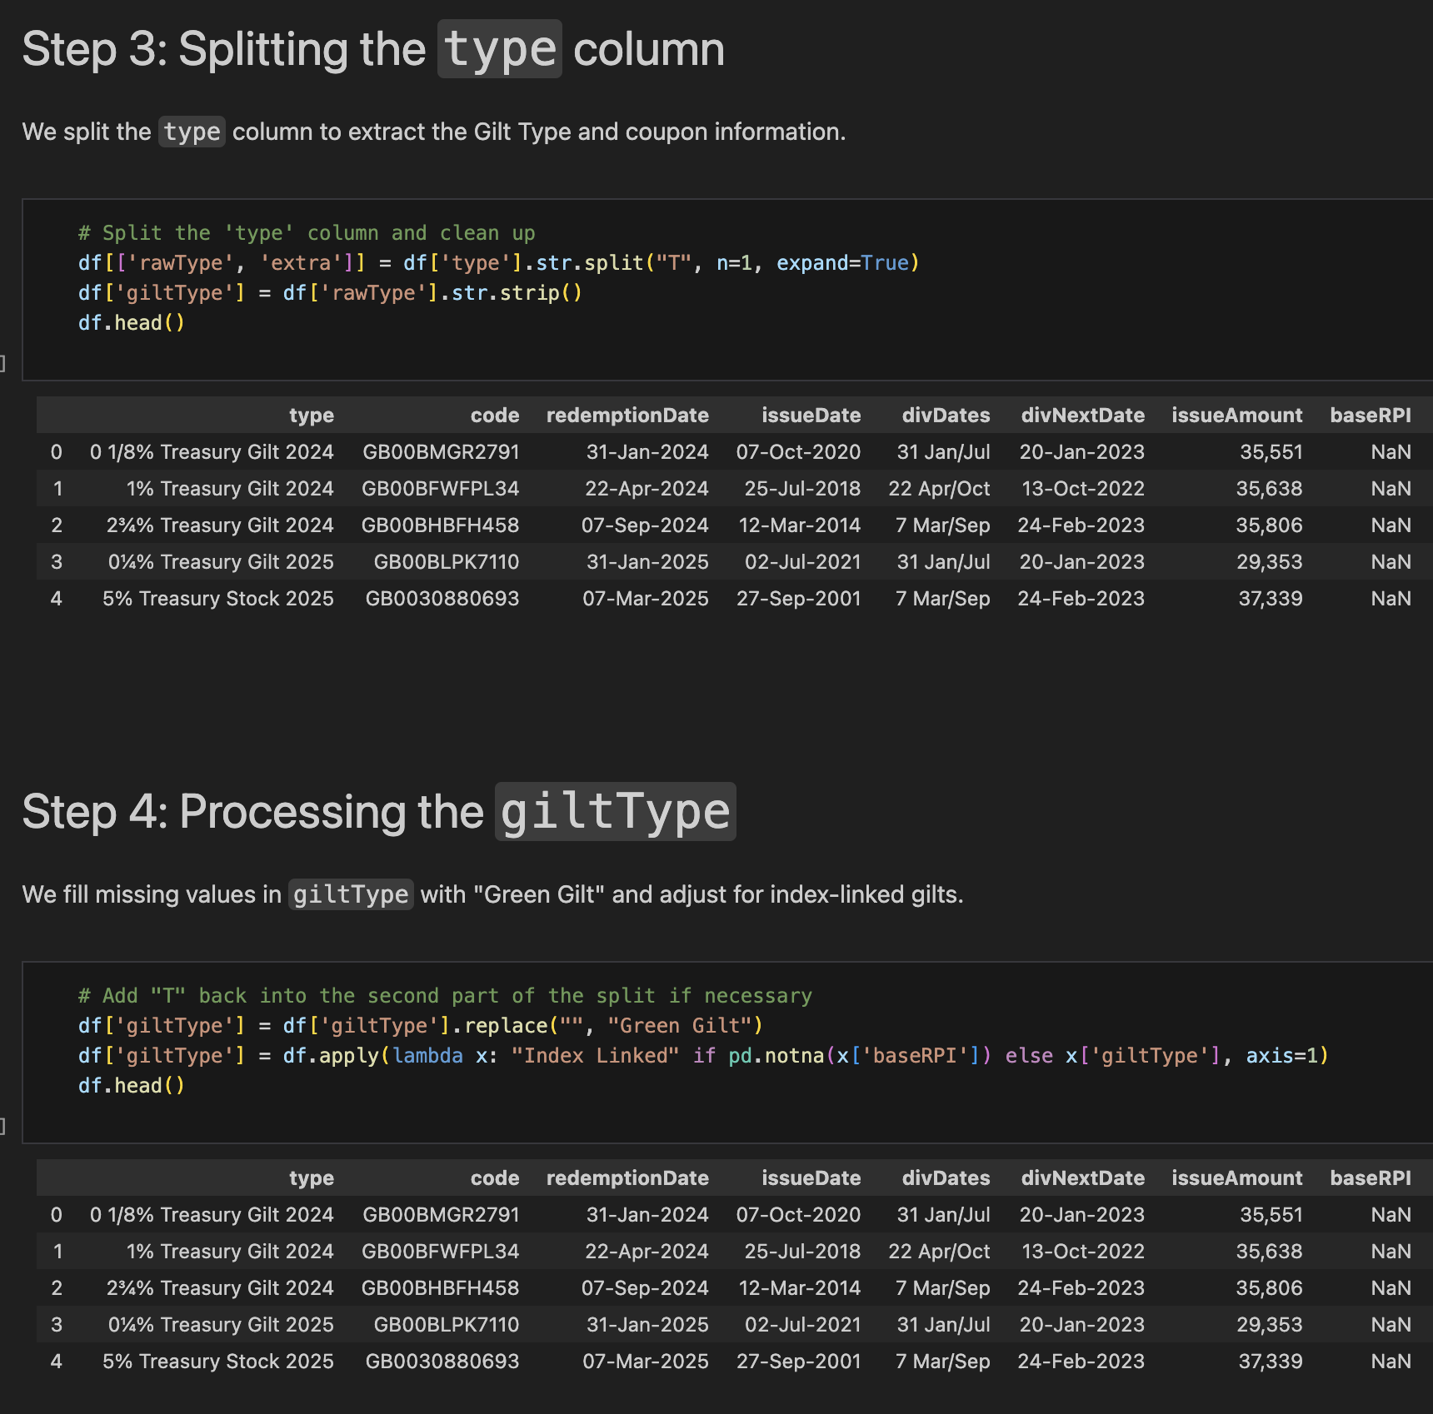
Example 1. UK Gilt Market
Excel | STATA | Python | JavaScript | CSS
And do the same thing with Python, using built-in Pandas methods:
Upper, lower: str.upper, str.lower
Split: str.split()
Length: str.len()
Substring: str[x:y]
Trim: str.strip()
github.com/jhellingsdata/RADataHub/blob/main/misc/cleaning_dmo_data.ipynb

Slide 34
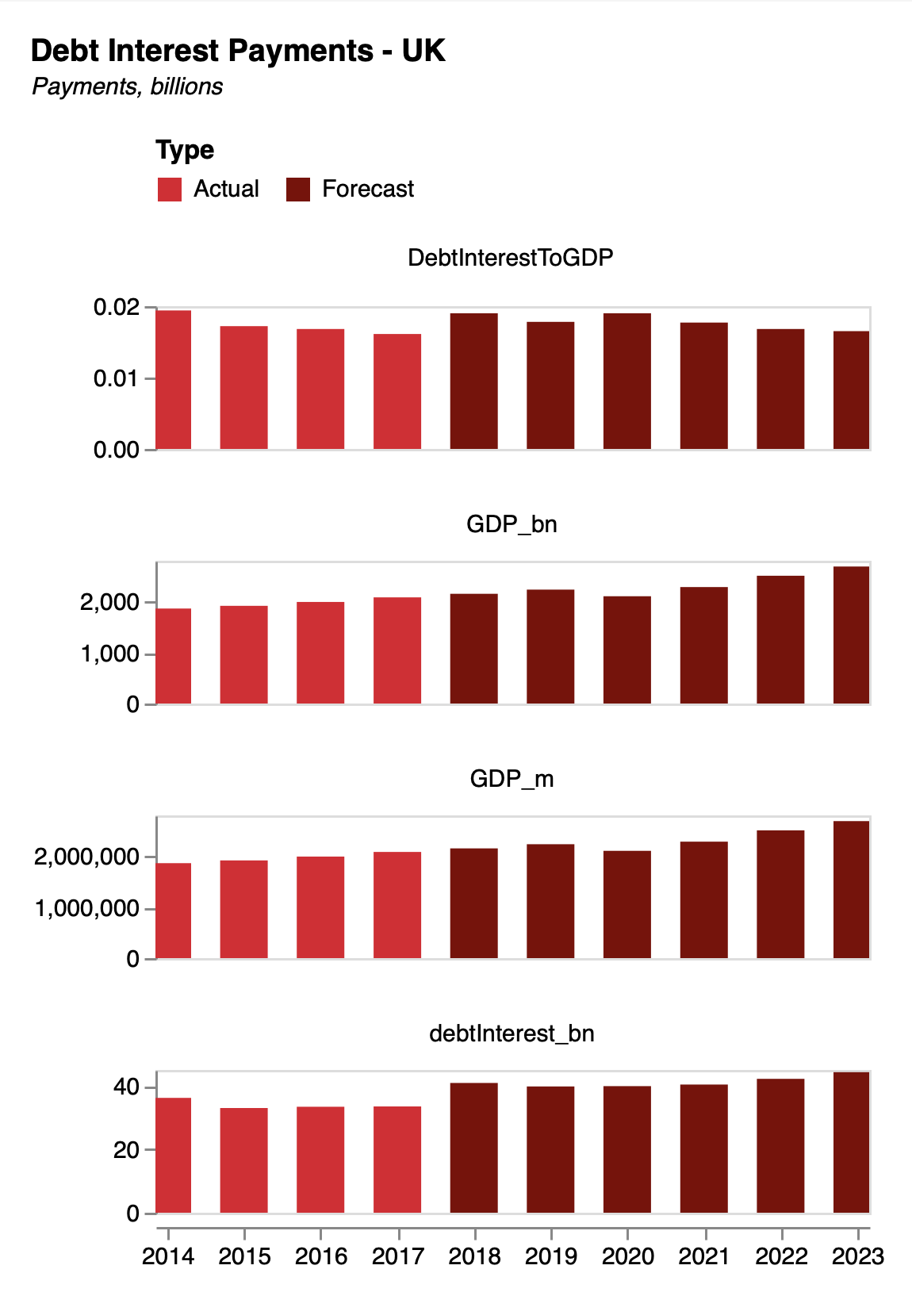
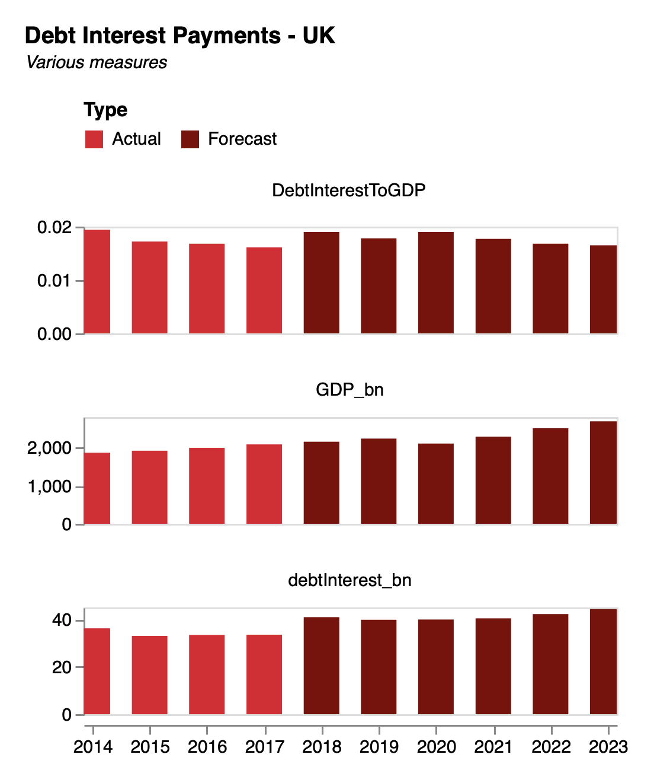
Example 2. In Vega-Lite.
Using conditionals in your charts
With a Vega-lite filter transform, we can restrict the data to just the variables or values we care about.
Recall our debt example from earlier in the course.
For code see: richarddavies.io/library
"transform": [
{"filter":{
"field": "Variable",
"oneOf":["DebtInterestToGDP", "GDP_bn", "debtInterest_bn"]
}}
],

Slide 35
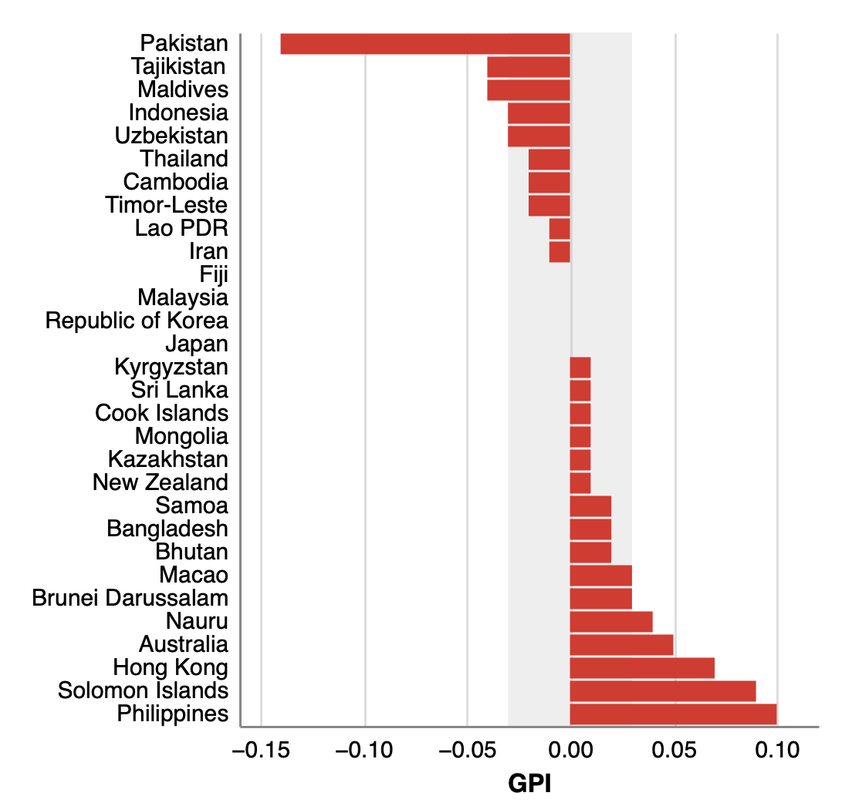
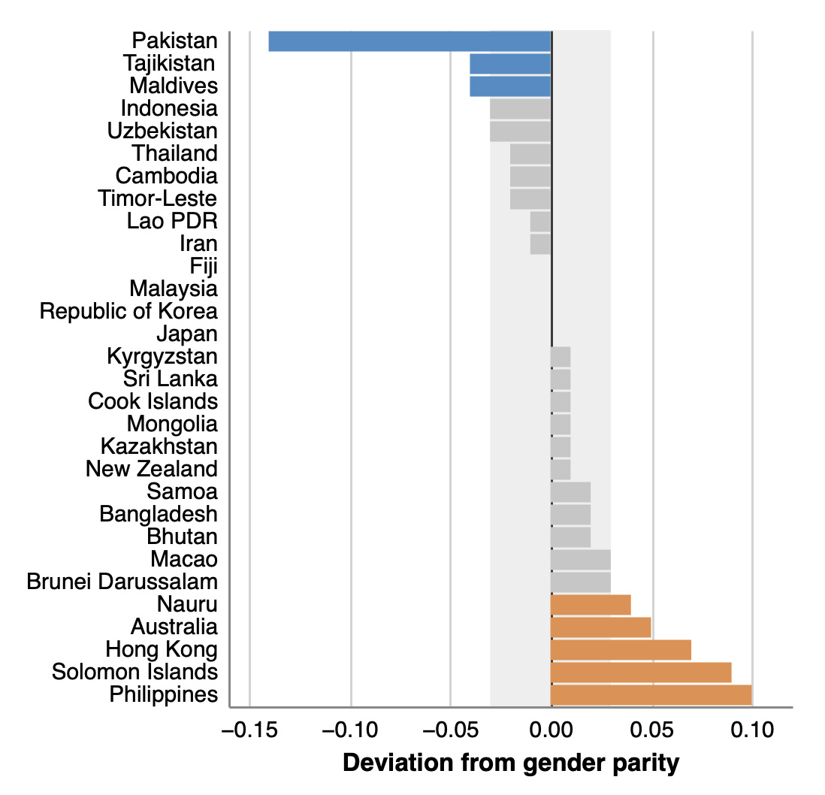
Example 3. In Vega-Lite.
Using conditionals in your charts
With a condition objects, we can define rules for encodings. For example, we can highlight points or rows by value.
"color": {
"condition": [
{
"test": "datum.diff < -0.035",
"value": "rgb(69,141,198)"
},
{
"test": "datum.diff > -0.035 && datum.diff <= 0.035",
"value": "rgb(198,198,198)"
},
{
"test": "datum.diff > 0.035",
"value": "rgb(230,142,72)}]

Slide 36
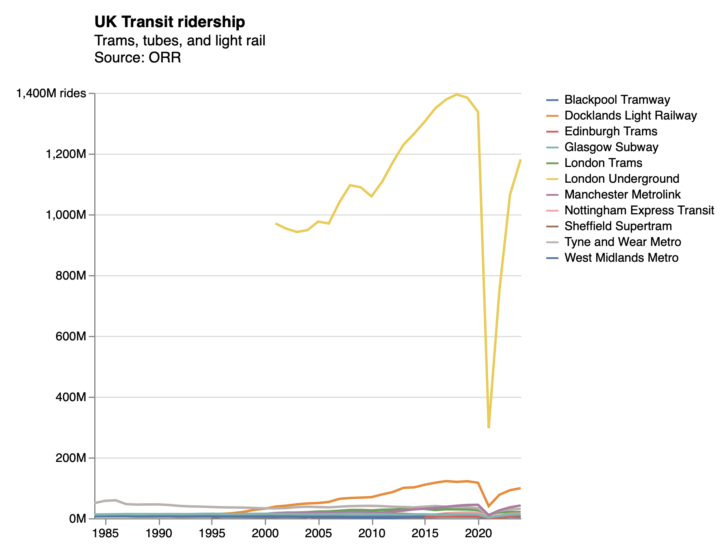
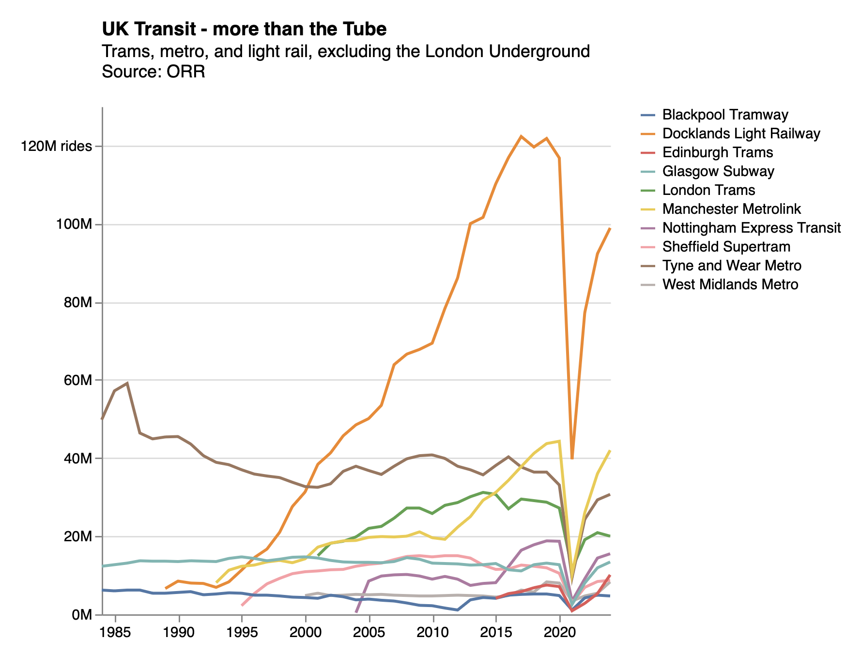
"transform": [
{
"filter":"datum.value < 250"
}
],
Example 4. Vega-Lite.
Using conditionals to filter extreme values
We can filter out the most extreme values to see what’s happening in the rest of the data:

Slide 37
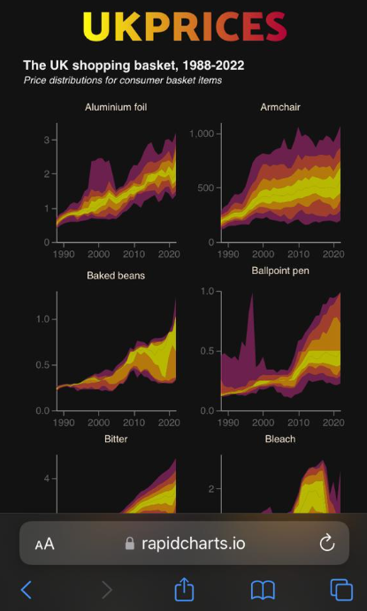
Example 5: screen sizes
Excel | STATA | Python | JavaScript | CSS
https://rapidcharts.io/prices
Phone
Desktop

Slide 38
Example 5: screen sizes
Excel | STATA | Python | JavaScript | CSS
<!-- CONDITIONAL SCRIPT TO EMBED BASED ON SCREEN WIDTH -->
<script>
// Find the current screen width:
let width = screen.width;
// Use an if function to pick the approprite visualisation:
if (width > 950) {
prices1 = "charts/ONSinflation/distributionsPerrenials_DarkWide.json";
} else if (width > 450) {
prices1 = "charts/ONSinflation/distributionsPerrenials_DarkMedium.json";
} else {
prices1 = "charts/ONSinflation/distributionsPerrenials_DarkNarrow.json";
}
// Now embed the chart, which will vary based on screen width:
vegaEmbed('#chart1', prices1, {"actions": false});
</script>

Slide 39
Example 6 – in CSS.
Excel | STATA | Python | JavaScript | CSS
/* Some CSS to alter the colour of my site */
body{
background-color: white;
}
/* Screen size 1 */
@media screen and (max-width: 450px) {
body {
background-color: lightblue;
}
}
/* Screen size 2 */
@media screen and (max-width: 600px) {
body {
background-color: blue;
}
}
/* Screen size 3 */
@media screen and (max-width: 800px) {
body {
background-color: pink;
}
}
What colour on:
Smartphone?
Laptop?
iPad?

Slide 40
5.2 Loops. Doing a task again and again, and again and again, and …

Slide 41
Code as a tree | Conditional statements influence which branch your code goes along.
Now your code is working nicely, for one country, or one company, or one year.

Slide 42
But you want to look at all the countries, all the companies, all the years.

Slide 43
Example 6 – in CSS.
Excel | STATA | Python | JavaScript | CSS
/* Some CSS to alter the colour of my site */
body{
background-color: white;
}
/* Screen size 1 */
@media screen and (max-width: 450px) {
body {
background-color: lightblue;
}
}
/* Screen size 2 */
@media screen and (max-width: 600px) {
body {
background-color: blue;
}
}
/* Screen size 3 */
@media screen and (max-width: 800px) {
body {
background-color: pink;
}
}
What colour on:
Smartphone?
Laptop?
iPad?

Slide 45
Loops.
Excel | STATA | Python | JavaScript | CSS
The Excel GUI is not built for iteration.
You can write loops in its background language VBA
This is fiddly

Slide 46
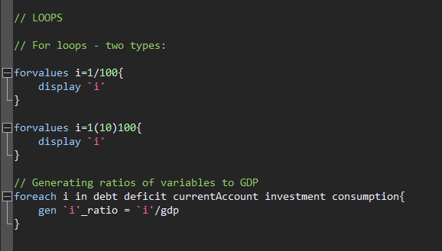
Loops.
Excel | STATA | Python | JavaScript | CSS

Slide 47
Loops.
Excel | STATA | Python | JavaScript | CSS
for i in range (1, 100):
print i
for i in range (1, 10, 100):
print i
for i in range (1, 100, 10):
print i
variables = ["debt", "deficit", "GDP", "inflation"]
for i in variables:
print(i)
An example of subtle differences between languages / functions.

Slide 48
Loops.
Excel | STATA | Python | JavaScript | CSS
for (statement_1; statement_2; statement_3) {
// Code block to run
}
What happens here:
Statement_1 runs once, before the code block starts.
Statament_2 defines a condition that must hold for the code block to run.
Statement_3 runs each time the code block has been executed.

Slide 49
Loops.
Excel | STATA | Python | JavaScript | CSS
for (let i = 1; i < 101; i++) {
console.log(i);
}
for (let i = 1; i < 101; i+10) {
console.log(i);
}

Slide 50
Loops.
Excel | STATA | Python | JavaScript | CSS
// Set a list of variables:
variables = ["debt", "deficit", "GDP", "inflation"]
// We can index these:
console.log(variables)
console.log(variables[0])
console.log(variables[3])
// Work out how long this thing is:
len = variables.length
// Iterate though it, printing out each particular variable
for (let i=0; i<len; i++) {
x = variables[i]
console.log(x)
}
Example in this week’s DropBox folder

Slide 51
Loops.
Excel | STATA | Python | JavaScript | CSS
Again CSS is not really built for looping
However, it can repeat commands. An example: @keyframes (an At-Rule).
One example is the @keyframes
@keyframes border-pulsate2 {
0% { border-color: #22e68b}
10% { border-color: rgba(230, 34, 75, 0)}
20% { border-color: rgba(230, 34, 75)}
30% { border-color: rgba(230, 34, 75, 0)}
40% { border-color: rgba(0, 47, 167)}
50% { border-color: rgba(230, 34, 75, 0)}
60% { border-color: rgba(250, 250, 0)}
70% { border-color: rgba(230, 34, 75, 0)}
80% { border-color: #22e68b}
}
.readingWeek {
background-color: #122b39;
border-radius: 10px;
border-style: dotted;
border-width: 5px;
height:100%;
animation: border-pulsate2 2s infinite;
}
Notes:
RS: insert example of a terrible chart

Slide 52
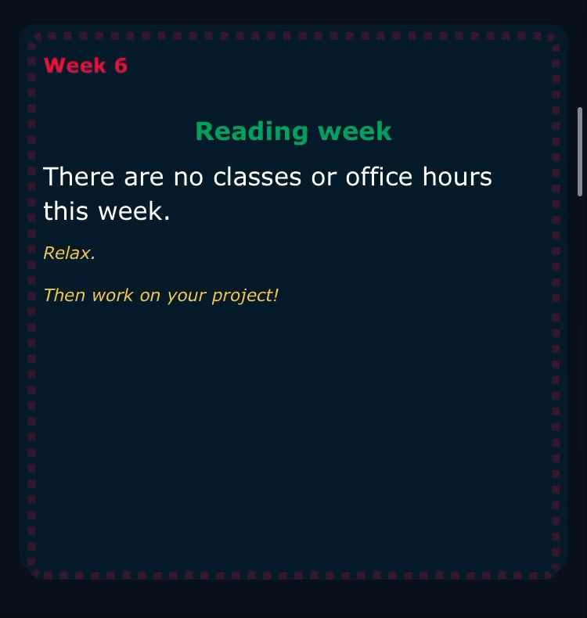
Loops.
Excel | STATA | Python | JavaScript | CSS
Again CSS is not built for looping
However, it can iterate over certain commands for a given time. One example
@keyframes border-pulsate2 {
0% { border-color: #22e68b}
10% { border-color: rgba(230, 34, 75, 0)}
20% { border-color: rgba(230, 34, 75)}
30% { border-color: rgba(230, 34, 75, 0)}
40% { border-color: rgba(0, 47, 167)}
50% { border-color: rgba(230, 34, 75, 0)}
60% { border-color: rgba(250, 250, 0)}
70% { border-color: rgba(230, 34, 75, 0)}
80% { border-color: #22e68b}
}
.readingWeek {
background-color: #122b39;
border-radius: 10px;
border-style: dotted;
border-width: 5px;
height:100%;
animation: border-pulsate2 2s infinite;
}

Slide 53


Using loops.
Exploding bubbles
https://rdeconomist.github.io/index_old
Code intuition:
For n bubbles, pick a size, x direction and y direction. Use random numbers so different each time.
Notes:
RS: insert example of a terrible chart

Slide 54
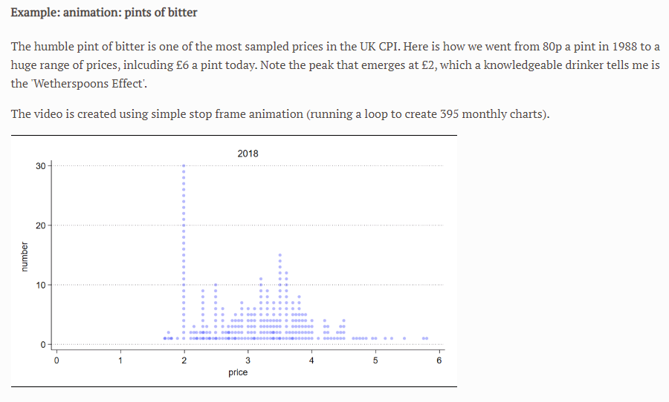
Using loops.
Stop frame animation
Watch the video here:
https://richarddavies.io/research/prices
Code intuition:
For dates i, draw histogram if date==i. Save chart as png.
Notes:
RS: insert example of a terrible chart

Slide 55
Using loops.
Batching analysis
Problem: We often have too much data
How can visualising help us understand the data in the early stage of a project?
Code intuition:
Think of a chart that summarises the data in some useful way:
[Useful options: histogram, percentiles as a swathe.]
Code this chart for one part (one firm, one year, one product).
Use a loop: for each product, draw the chart
Example: UK CPI data, which has ~1300 products.
Notes:
RS: insert example of a terrible chart

Slide 56
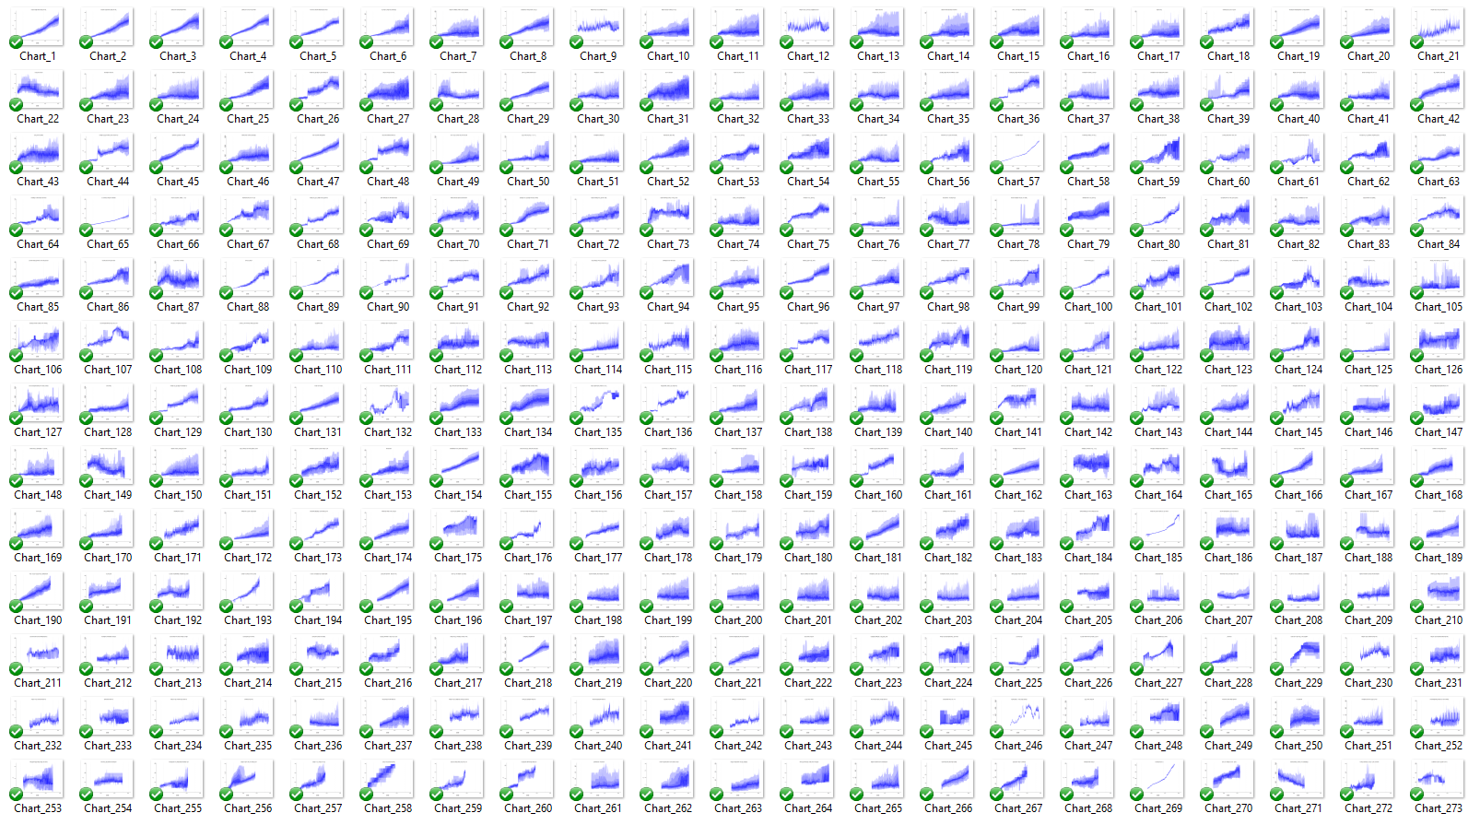
Notes:
RS: insert example of a terrible chart

Slide 57
It’s time to complete your unit evaluation surveys
bristol.ac.uk/unit-evaluation

Slide 58
5.3 Building dashboards. Using loops and conditionals to analyse data

Slide 59
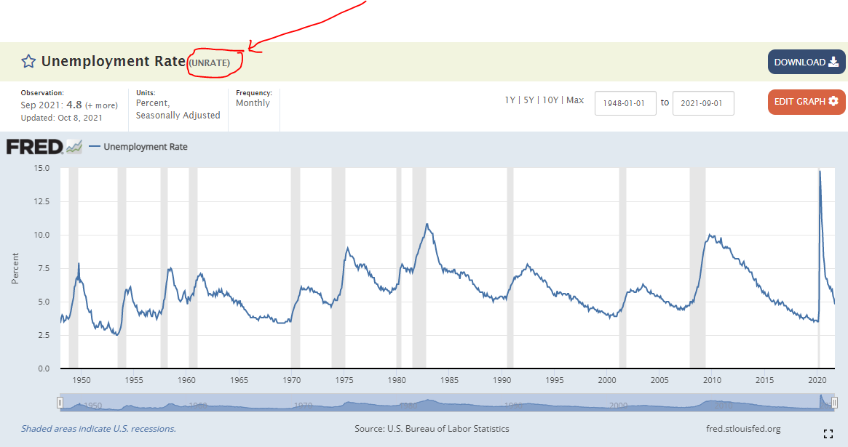
Break. Find two series on FRED that you are interested in. Make a note of their codes: https://fred.stlouisfed.org/

Slide 60
Practical. Looping over a list of countries to create create dynamic API-linked charts.

